Slide 1
Free Body Diagrams
FBDs

Slide 2
Force Definitions
Forces affect the motion of objects
Force is a vector
F= force, m= mass, a= acceleration
Force is measured in Newtons (N)

Slide 3

Gravity
The force of Gravity is written as:
One Newton is about equal to the weight of a ______________.
How can we draw an apple falling towards the ground?
FBD
V

Slide 4
Tension
The Tension Force is written as:
Tension is a ___________ force applied by strings or ropes.
How can we draw an apple suspended by a string?
FBD

Slide 5
Normal Force
The Normal Force is written as:
The normal force is a ___________ force.
The normal force is ________ to and __________ gravity.
How can we draw an apple sitting on a desk?
FBD

Slide 6

Applied Force
The Applied Force is written as:
The applied force is a _____________ force.
How can we draw a box being pushed horizontally?
FBD

Slide 7
Friction Force
The Force of Friction is written as:
The force of friction is a ____________ force.
It is ____________ to the direction of motion.
How can we draw box being slowed to a stop by friction?
FBD
V

Slide 8
Net Force (F_{net})
The Net Force is the sum of all forces acting on an object
When the net force is _____________ the object moves with uniform velocity (or is stationary).
When the net force is _____________ the object moves with accelerated motion.
How can we draw all the forces acting on the box?
FBD
V

Slide 9
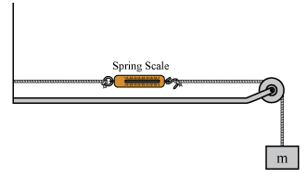

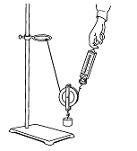
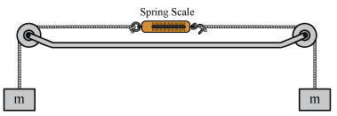
Your Turn
Complete the Force Introduction Investigation.

